Slide 1
Building Construction Technology program
New Courses Offered

Slide 2
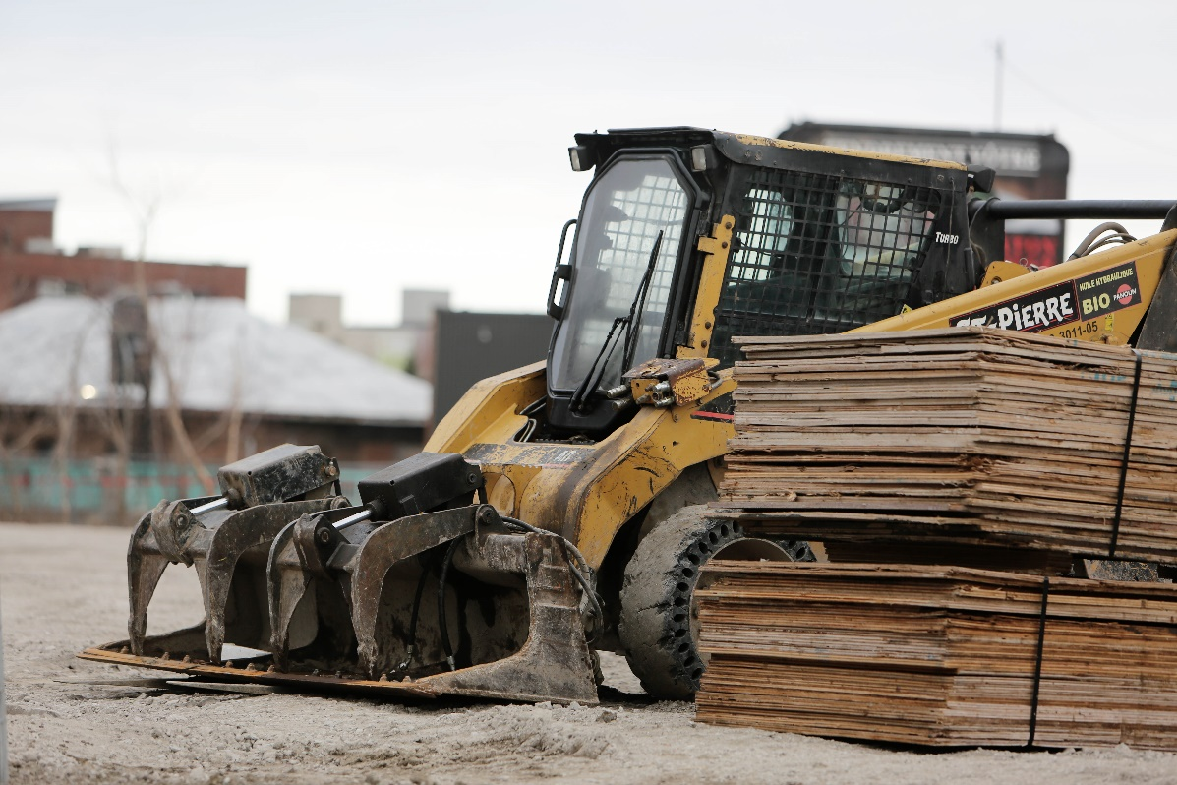
Earth Moving Tractor-Backhoe Loaders
Backhoe Tractor is taught within 1 month
There are highly experienced teachers
A driving license is issued upon completion
Sufficient time is allocated for training and work-based testing.

Slide 3

Construction Helmet
Helmet is a protective gear
Students are offered onsite training on safety matters
The college offers, first aid training on students, in relation to safety matters on the sites
Notes:
The construction Helmet is used by any construction engineers and everybody else in the construction site. The helmets come in different sizes, worn on the head as protective gears. While some helmets are worn once, some are used to withstand multiple breaks. During a fall or impacts from a falling object, the sponge in the inside of the helmet, help reduce the impacts or injury on the user. Often, the helmets is not completely perfect, since one may still sustain injuries while on the helmets. As such, the helmet is used to mitigate adversities possible with a fall or a collision in the construction site. Any sign of damage on the helmets, implies immediate replacement of the same.

Slide 4
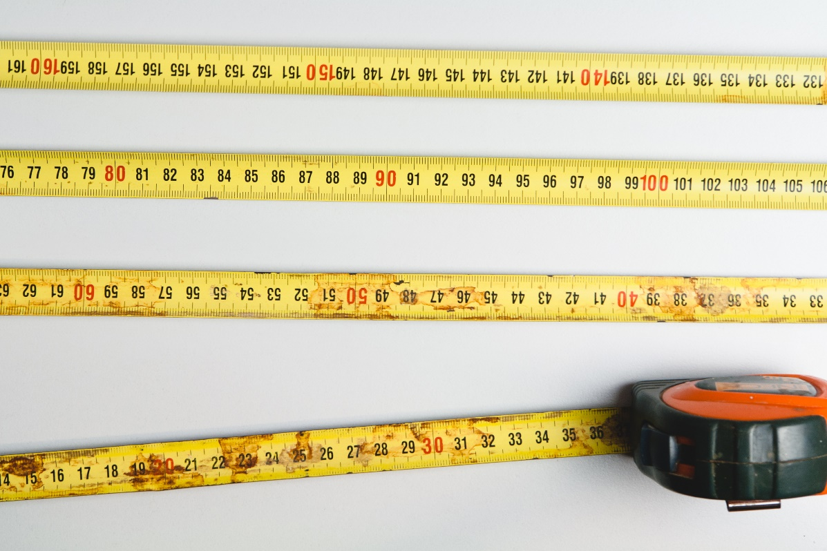
Tape Measure
The college offers extensive training on budgeting, costing and approximation.
Various tools used in measuring are introduced to the students.
Tools maintenance practices are taught in the college
Notes:
A tape measure is very useful in taking measurement in every construction work. A tape measure is a portable measurement device used to quantify the size of an object or the distance between objects. The advent of the tape measure, is the SI unit of measurement. Tape measure is relatively safe and easy to use in the construction work, given the ease to interpret calibration. For a prolonged life, the tape measure is kept clean, and well fitted in the safety box. Many of the steel blade tapes comprise of tension-control brakes that lock the blade in place for measuring spans. Longer tapes have a crank on the side of the case to retract the cloth tape.

Slide 5

Hammer
Learners acquire skills on how to use hammer
Each learner is allocated personal construction tools
Different types of hammers, and related tools are taught
The learners are given hands-on skills by learning from construction sites where these tools are used.
Notes:
Hammer, is a handheld tool, that is used to strike other objects in the construction work, especially driving in nails on woods, or shaping metallic objects. There are many types of hammer, comprising of the claw hammer, which is the most common as above photo used to drive and pull out nails. The head and handle, are the major components of the hammer. Some hammers as above, have the tail, which is used to pull out nails. The heads of a hammer are made of high carbon, heat-treated steel for strength and durability. The hard materials of the hammer, help in alienating the hammer from chipping or cracking as results of repeated hits.

